Slide 1

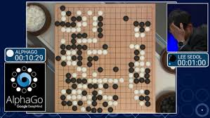
NPTEL
Video Course on Machine Learning
Professor Carl Gustaf Jansson, KTH
Week 5 Machine Learning enabled
by prior Theories
Video 5.4 Reinforcement Learning – Part 2 : Learning Algorithms

Slide 2
Distinctions in Reinforcement Learning
Passive versus Active learning
On-policy versus Off-policy learning
Exploitation versus Exploration learning
Model-based versus Model-free learning

Slide 3
Passive Learning versus Active learning
Passive learning
A Passive Agent executes a fixed policy and evaluates it. The agent simply watches the world going by and tries to learn the utilities of being in various states.
Active learning
An Active agent updates its policy as it learns while acting in an uncertain world. An active agent must consider what actions to take, what their outcomes may be, and how they affect the rewards achieved via exploration. Active learning is most typical for the true reinforcement learning cases.

Slide 4
On-policy versus Off-policy
In the Planning DP case an agent could conduct off-policy planning, that is, formulate a policy without needing to interact with the world. In off-policy methods, the agent´s policy used to chose its actions is called the behavior policy which may be unrelated to the policy that is evaluated and improved, called the estimation policy.
In the situation that a complete model of the environment is NOT available for the agent, i.e. elements of T(s,a) and R(s´|s,a) are lacking, and then we must typically engage in on-policy planning, in which we must interact with the world to better estimate the value of a policy while using it for control.
In the on-policy mode the planning and learning parts are interwoven.

Slide 5
Exploration versus Exploitation
Actions in RL systems can be of the following two kinds:
Exploitation actions: have a preference for past actions that have been found to be effective at producing reward and thereby exploiting what is already known. The Planning DP case is completely in this genre.
Exploration actions: have a preference for exploring untested actions to discover new and potentially more reward-producing actions. Exploration is typical for the true reinforcement learning cases.
Managing the trade-off between exploration and exploitation in its policies is a critical issue in RL algorithms.
One guideline could be to explore more when knowledge is weak and exploit more when we have gained more knowledge.
One method: ε-greedy keep to exploitation as long as actions has the probability 1-ε. If no action which satisfies this condition is found, the agent turns to exploration. ε is a hyper-parameter controlling the balance between exploitation and exploration.

Slide 6
Model-free versus Model-based Reinforcement Learning
In the situation that a complete model of the environment is NOT available for the agent, i.e. elements of T(s,a) and R(s´|s,a) are lacking, RL offers two different approaches.
Model-based RL algorithms.
One approach is to try to learn an adequate model of the environment and then fall back on the
planning task for a complete model to find a policy.
That is, if the agent is currently in state s, takes action a, and then observes the environment transition to state s´ with reward r , that observation can be used to improve its estimate of T( s, a) and R(s´| s,a)
through supervised learning techniques.
Model-free algorithms.
However a model of the environment is not necessary to find a good policy.
One of the most classic examples is Q-learning, which directly estimates optimal so called Q-values of each action in each state (related to the utility of each action in each state), from which a policy may be derived by choosing the action with the highest Q-value in the current state.

Slide 7
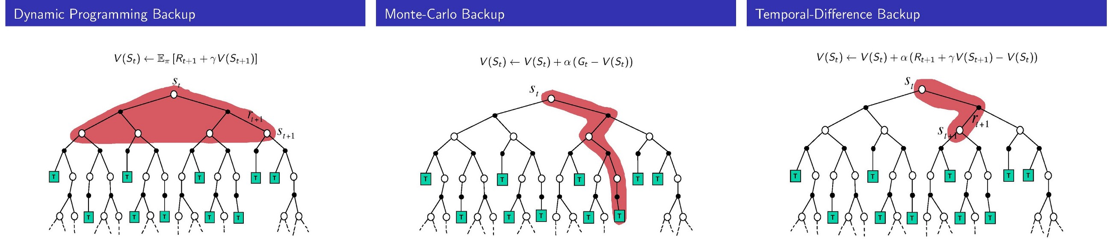
Solving a Re-inforcement Learning Problem
Model-based approaches
Adaptive Dynamic Programming (ADP)
Model-free approaches
Monte Carlo simulation (MC Direct Estimate Temporal-Difference learning (TD) Q-learning –off-policy
SARSA – on-policy

Slide 8
Model-free Direct Estimation of the value function
Estimate the value function for a particular state s as the average of total rewards of a sample of epochs (calculating from s to end of epoch)
The so called ´Reward to go´ of a state s is the sum of the (discounted) rewards from that state until a terminal state is reached. The estimated value of the state is based on the ´Rewards to go´.
Direct Utility Estimation keeps a running average of the observed ´rewards‐to‐go´ for each state s.
Value (s) = average of ( all (´Reward to go´ (s) for all episodes e in the sample)
As the number of trials goes to infinity, the sample average converges to the true utility for state s.
Drawback: very slow convergence.

Slide 9
Model-based Adaptive Dynamic programming(ADP)
The strategy in ADP is to first complete the partially known MDP model and then regard it as complete applying the Dynamic Programming technique as in the planning case with complete knowledge.
γ
V(s):= ∑ T (s,a) * (R(s´|s,a)+ * V(s') )
s´
To be learned
Algorithm for iteratively updating estimates of R(s´|s,a) and T(s,a)
Collecting examples of rewards for s, a, s triples
Collecting examples of s, a and s´ triples
Taking averages of collected rewards
Calculate the fraction of time s,a leads to s´.

Slide 10

Model-based Learning :Monte Carlo Simulation (MC)
Monte Carlo metods are computational algorithms that are based on
Repeated random samples to estimate some target properties of a model.
Monte Carlo Simulations simply apply Monte Carlo methods in the context of Simulations.
Monte Carlo Reinforcement Learning MC methods learns directly from samples of complete episodes of experience.
MC is model-free: no explicit model of MDP transitions and rewards is built up.
MC takes mean returns for states in sampled episodes. The value expectation of a state is set to the iterative mean of all the empirical returns (not expected) for the episodes.
First-visit MC: average returns only for first time s is visited in an episode.
Every-Visit MC: average returns for every time s is visited in an episode.

Slide 11
Algorithm for first-visit Monte Carlo
Initialize the policy, state-value function arbitrarily 2: Returns(s) ← empty list
2. Start by generating an episode E according to the current policy π.
3. For each s in E
Begin
4. if this is the first occurrence of this state add the return received to the returns list.
5. calculate an iterative means (average) over all returns
6. set the value of the state as that computed average
End
Repeat step 2-4 until convergence.
The every-visit algorithm simply modifies step 4.

Slide 12
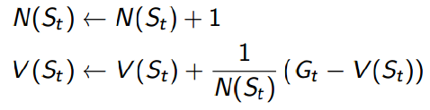
Using an Incremental Mean in Monte Carlo Simulation
It is convenient to convert the mean return into an incremental update so that the mean can be updated with each episode and one can follow the progress made with each episode.
V(s) is incrementally updated for each state St, with return Gt.

Slide 13

Example of Monte Carlo Simulation
An undiscounted Markov Reward Process with two states A and B
Transition matrix and reward function are unknown
Two sample episodes
E1
E2
As an example A+3 → A indicates a transition from state A to state A, with a reward of +3.
first-visit MC
Return for A in EI = +3+2-4+4-3 = 2 Return for A in E2 = +3-3 = 0 V(A) = 1/2(2 + 0)=1 Return for B in EI = -4+4-3 = -3 Return for A in E2 = -2+3-3 =-2 V(B) = 1/2(-3 + -2)= -5/2
every-visit MC
V(A) = 1/4(2 + -1 + 1 + 0) = 1/2 V(B) = 1/4(-3 + -3 + -2 + -3) = -11/4

Slide 14
Model-free learning: Temporal difference (TD) learning
Temporal difference (TD) learning is a class of model-free reinforcement learning methods which learn by bootstrapping from the current estimate of the value function.
TD algorithms:
sample from the environment, like Monte Carlo simulations and
perform updates based on current estimates like adaptive dynamic programming methods.
While Monte Carlo methods only adjust their estimates once the final outcome is known, TD methods adjust predictions before the final outcome is known. Typically TD algorithms adjust the estimated utility value of the current state s based on its immediate reward and the estimated value of the next state s´. The term ´temporal´ is motivated by the temporal relation between states s and s´.
The Temporal difference equation
V (s) ← V (s) + α * ( R (s,a) + γ *V (s´) − V (s) )
where α is a learning rate parameter (hyper parameter).

Slide 15
To be continued in Part 3

